Slide 1
Anonymous e-cash: history
Crypto
magic
David Chaum, 1982
Blind signature:
two-party protocol to create digital signature without signer knowing the input

Slide 2

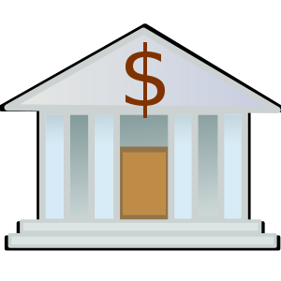

Anonymous e-cash via blind signatures
User | Balance
… | …
 | 10
… | …
 | 5
Spent coins
…
Withdraw anonymous coin
{317038628684424}
9
31703862…
Deposit coin # 317038628684424
{317038628684424}
6
OK
Bank cannot link the two users

Slide 3
1. User (Blue) Prepares a Token
The blue user wants to withdraw digital cash from the bank.
Instead of directly requesting a specific token, they blind the token using a blinding algorithm (think of it as hiding the content).
🔓 3. User Unblinds the Token
The user unblinds the token—now they have a bank-signed token that is:
  Valid (the bank's signature checks out),
  But anonymous (the bank can't recognize what it signed).
🧑‍🦰 4. User (Red) Spends the Token
The user now uses this signed token in a transaction (for example, a payment to a merchant).
The merchant or recipient verifies the token using the bank’s public key.
It’s confirmed as authentic digital cash, even though the bank cannot trace who originally withdrew it.
💳 2. Bank Signs the Blinded Token
The bank signs the blinded token without knowing its content (thanks to the blinding).
This creates a blind signature—a valid signature that can later be verified as authentic, but the bank has no idea what it signed.
The signed, blinded token is returned to the user.

Slide 4
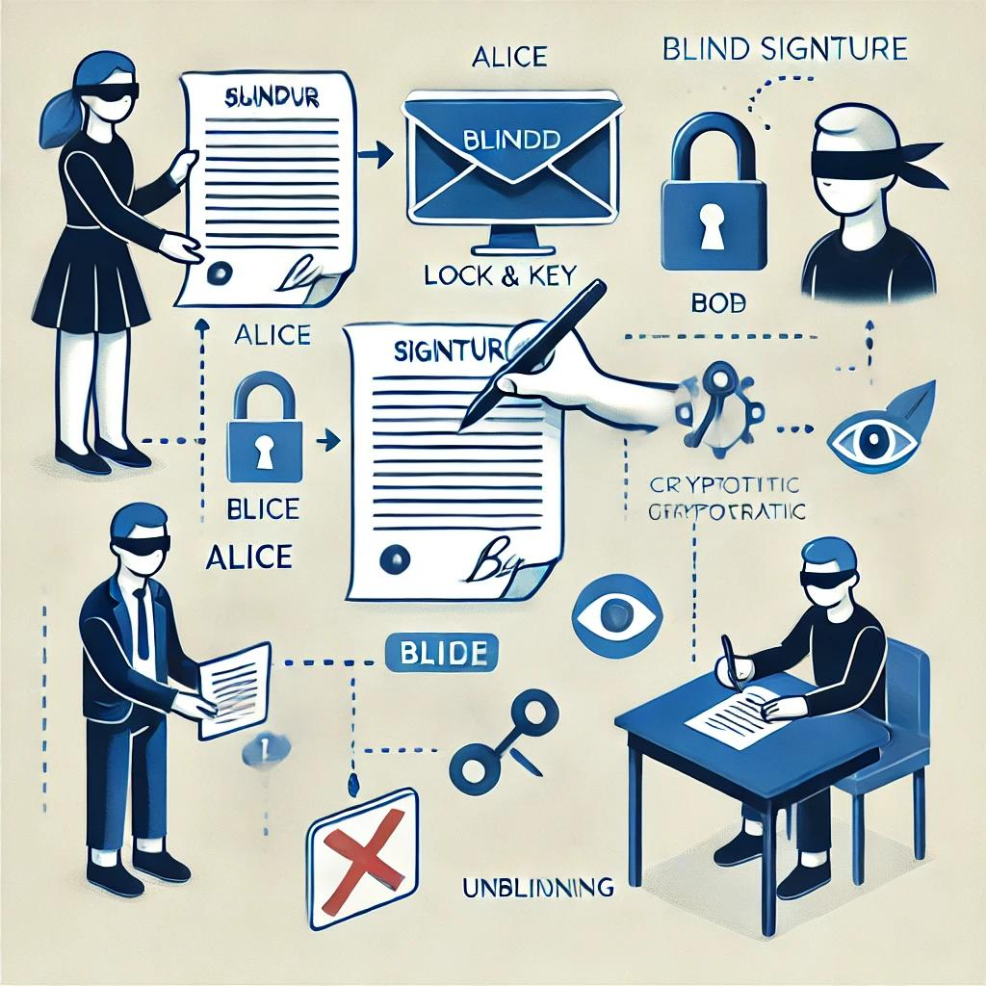
How Blind Signatures Work: Alice & Bob
Imagine Alice wants Bob to sign a message without knowing its contents.
She blinds it using a mathematical function and sends it to Bob.
Bob signs the blinded message and returns it.
Alice then unblinds the signed version to obtain a valid signature on the original message.
This ensures privacy, as Bob never sees what he signs.
It's like signing a folded paper with carbon paper underneath.

Slide 5
Real-World Applications
Blind signatures are used in various domains:
E-Voting: To maintain voter anonymity while ensuring vote integrity.
Digital Cash: For untraceable digital currency.
Anonymous Credentials: To authenticate users without identity exposure.
Medical Systems: Patient data approvals while preserving privacy.

Slide 6
In medical systems, blind signatures allow sensitive patient data to be approved or certified by authorized personnel (such as hospitals or regulatory bodies) without revealing the actual content of the data. Here's how it works:
A patient or healthcare provider "blinds" the medical data before sending it for approval. This means the data is mathematically altered in a way that hides its contents. An authority (like a medical board) then signs this blinded data, confirming that the format or purpose is valid, without ever seeing the actual patient details. Once the signature is returned, the original sender unblinds the data, revealing the content along with a valid signature.
This ensures that the signature is legitimate and verifiable, while the privacy of patient information is completely protected. It's highly relevant in use cases like anonymized medical trials, health ID approvals, and cross-border health data sharing, where compliance and privacy must coexist.

Slide 7
Simulating Blind Signatures Using Multichain
Create asset alice_asset 1000
You are:
Defining an asset type (like a token or vote).
This definition is recorded on the blockchain—it becomes part of the ledger.
No specific transaction involving the asset (like transferring it) has happened yet—you're just declaring the asset exists.
So yes, asset creation is public and visible on-chain.

Slide 8
Simulating Blind Signatures Using Multichain
Does It Make Sense to Blind the Asset Creation Step?
No. Blinding is not needed during asset creation, because:
You’re not transferring or using the asset yet.
There’s no sensitive data involved in the definition itself.
Everyone on the chain can see the asset exists—it's not private

Slide 9
Simulating Blind Signatures Using Multichain
Blinding is used when:
A participant wants to protect the content of a message or transaction (e.g., a vote, a token transfer reason).
With Encryption Algorithms
The signer (e.g., Bob) should not know what they’re signing.
The transaction (not the asset) contains sensitive information.

Slide 10
Simulating Blind Signatures Using Multichain
Correct Use Case of Blinding in Multichain
A better fit would be:
You create the asset publicly (no blinding).
When transferring the asset (e.g., casting a vote), you blind the transaction message before it is signed by an authority or recorded on-chain.
This way, the content of the vote or reason for transfer is private, while the asset movement is still verifiable.

Slide 11
Simulating Blind Signatures Using Multichain
Example Suppose Three Characters
1.Create two Bank wallet address A and C having there own Assets
2.Alices Create binded Message through RSA or Else Request of withdraw cash to the wallet in which Bank sign unblinded recorded the transcational ID on blockchain
3.Bank send the back the transactional ID to Alice
4.Alice send this C inroder to withdraw the cash from the Bank verify the Signature

Slide 12
Anonymity & decentralization: in conflict
Decentralization often requires transparency (everyone sees the ledger),
But anonymity means hiding who did what.
So if you're building a decentralized system and want full auditability, you might have to reduce anonymity.
On the other hand, if you protect anonymity too much, you can’t track:
Who cheated
Where illegal funds went
Whether someone double-spent or abused the system

Slide 13
Why Anonymity Becomes
Difficult to Maintain on Blockchain
Despite being pseudonymous, blockchain transactions are public and immutable.
Each wallet address can be traced over time, revealing patterns. As users interact with exchanges, dApps, and services requiring identity verification (KYC), their wallet addresses become linkable to real-world identities.
This erodes true anonymity, especially when combined with data analytics.

Slide 14
De-anonymization on Blockchain:
Connecting the Dots
Blockchains like Bitcoin are not anonymous but pseudonymous. Analysts can connect multiple wallet addresses by observing transaction graphs, timing, and behavior.
By clustering addresses and analyzing network interactions, it's possible to uncover the identity behind certain transactions.
This is called 'de-anonymization' and is often used in forensic investigations.

Slide 15
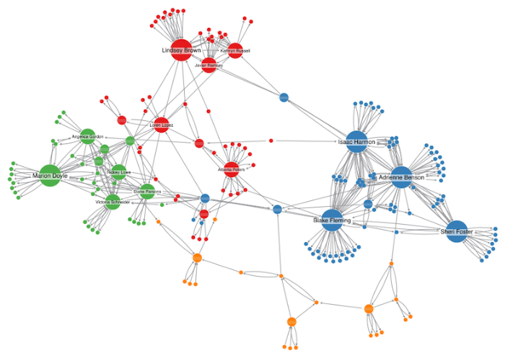
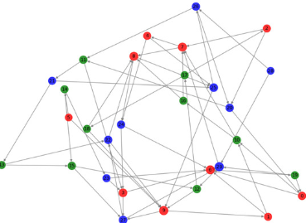
DE anonymize network Graph
Address Clustering network Graph

Slide 16
Multichain Example: Traceability Despite Anonymity
Example in Multichain:
1. User1 sends an asset: `send asset1 50 address2`
2. Observer traces this asset across blocks and transactions.
3. Even if User2 reuses new addresses, the pattern and frequency of transactions can be analyzed.
4. These patterns help link back to the original sender, reducing effective anonymity.
Multichain provides permissioned environments, but analytics can still de-anonymize with access.

Slide 17
[
{
"address": "1AliceMainAddress",
"ismine": true,
"assets": [
{
"name": "tokenX",
"qty": 400
}
]
},
Command to List All Addresses on the Node
{
"address": "1AliceA",
"ismine": true,
"assets": [
{
"name": "tokenX",
"qty": 100
}
]
} ]
}
]

Slide 18
How to de-anonymize Bitcoin

Slide 19
So, unlinkable?
While receiving at a fresh address does help improve privacy, it does not guarantee unlinkability because:
🔎 Observers can still analyze:
Transaction graph: Even if you use new addresses, if assets are moved together later or follow a pattern, they can be linked.
Timing and frequency: If payments happen on a fixed schedule or in similar amounts, observers may guess the user identity.
Change addresses: Many wallets send “leftover” funds back to a newly generated change address—which still belongs to the sender. This can unintentionally link addresses.
UTXO behavior: In Bitcoin-like systems, when you spend from multiple UTXOs (unspent outputs), your input addresses may be linked together in one transaction.

Slide 20

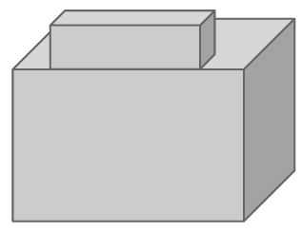

Alice buys a teapot at Big box store
5
8
3
Single
transaction
6

Slide 21
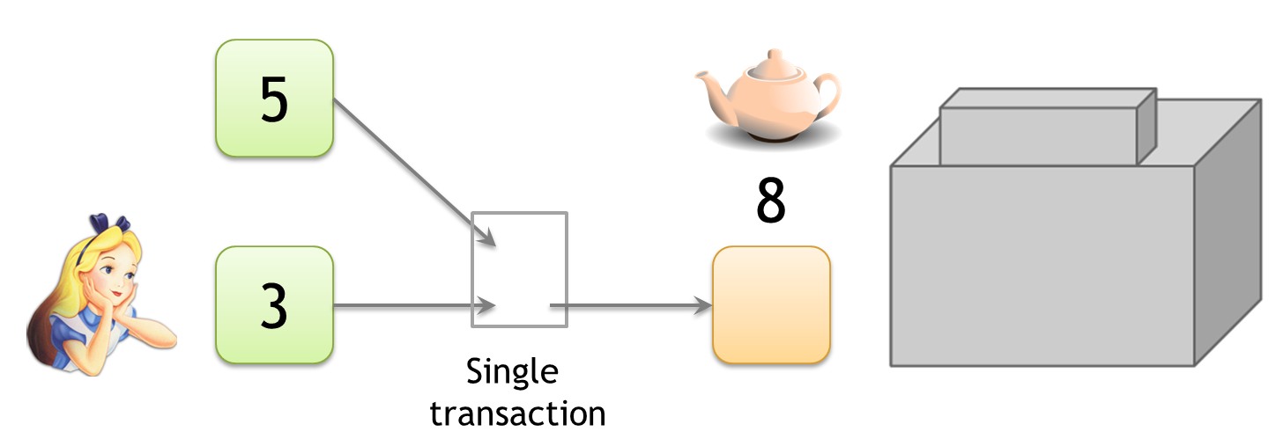
Linking addresses
Shared spending is evidence of joint control
Addresses can be linked transitively

Slide 22
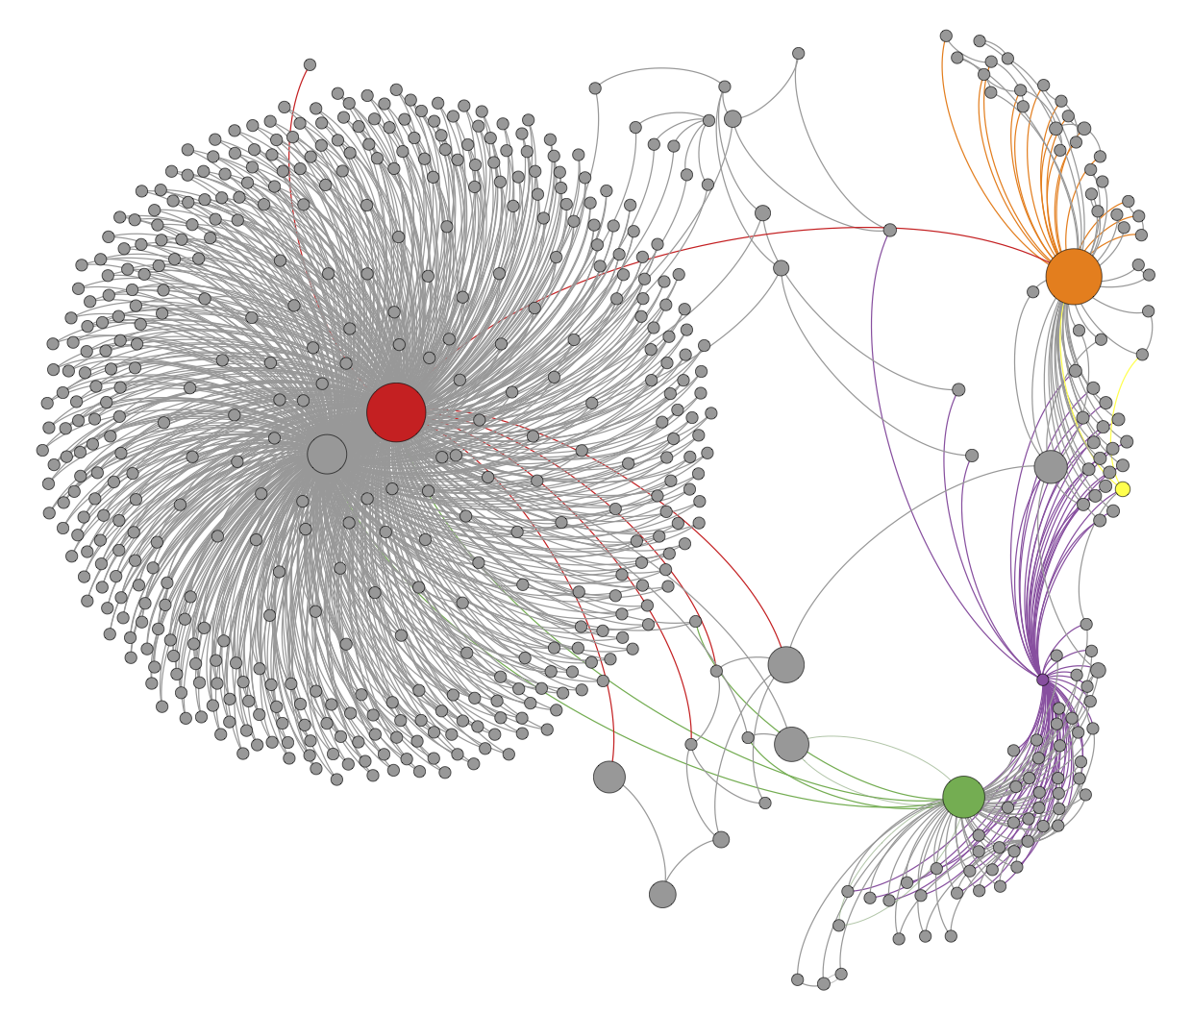
Clustering of addresses
An Analysis of Anonymity in the Bitcoin System
F. Reid and M. Harrigan
PASSAT 2011

Slide 23
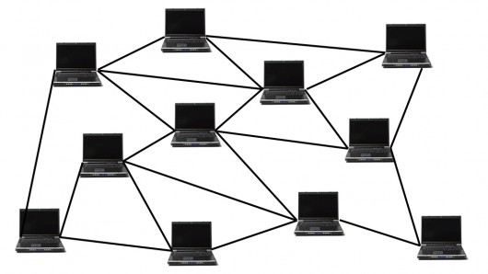

Network-layer de-anonymization
“The first node to
inform you of a
transaction is probably
the source of it”
Dan Kaminsky
Black Hat 2011 talk

Slide 24
Solution: use Tor
Tor (The Onion Router) is an anonymity network that routes internet traffic through a series of volunteer-operated nodes (called relays or routers). It encrypts and re-encrypts your data multiple times and sends it through several random nodes.
This approach is inspired by a mix network, where traffic is:
Shuffled (to break timing patterns)
Encrypted in layers (like layers of an onion)
Routed through unpredictable paths

Slide 25
Lecture Theme to Move as More Anonymity for privacy Preservation

Slide 26
Mixing

Slide 27
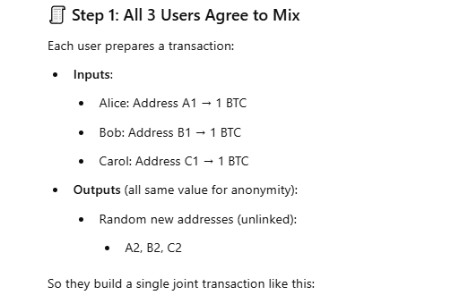

To protect anonymity, use an intermediary
If Alice sends 1 BTC directly from A1 → A2, anyone can trace this on the blockchain.
But if multiple people (Bob, Carol) join in and all their funds are mixed in one transaction:
It becomes unclear which input belongs to which output.

Slide 28
{
"inputs": [
{"txid": "txA", "vout": 0, "address": "A1"},
{"txid": "txB", "vout": 1, "address": "B1"},
{"txid": "txC", "vout": 0, "address": "C1"}
],
"outputs": [
{"address": "A2", "amount": 1.0},
{"address": "B2", "amount": 1.0},
{"address": "C2", "amount": 1.0}
]
}

Slide 29
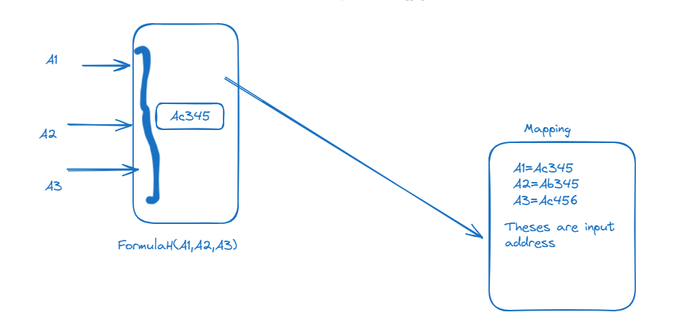

Slide 30
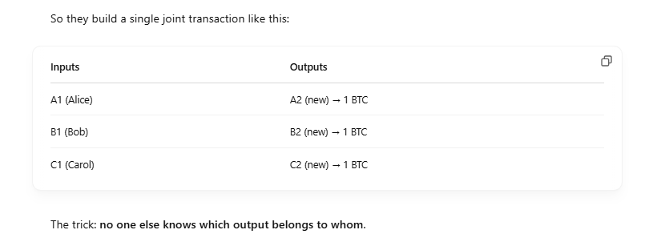
To protect anonymity, use an intermediary

Slide 31
Dedicated mixing services
Promise not to keep records
Don’t ask for your identity

Slide 32
Back to online wallets
Reputable, often regulated, businesses
Typically require identity, keep records ➔ no anonymity w.r.t. wallet service
Users trust them with their bitcoins ➔ keep them for longer ➔ bigger anonymity set w.r.t. everyone else

Slide 33
Rest of this lecture:
assume a user for whom the trust requirements and anonymity properties of online wallets are unacceptable

Slide 34
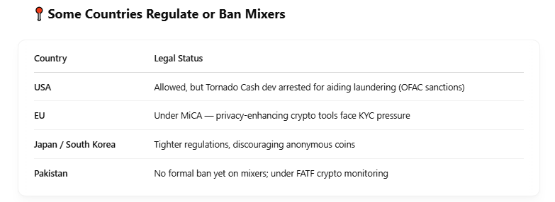
Legal Status: It Depends on Jurisdiction
📍 Some Countries Allow It (with limits)
Bitcoin mixing is not illegal in most countries (like the US, EU, Pakistan, etc.)
BUT — using it to hide criminal activity (e.g., money laundering, ransomware proceeds) is illegal
Think of it like cash: legal to use, but illegal to use in a drug deal.

Slide 35
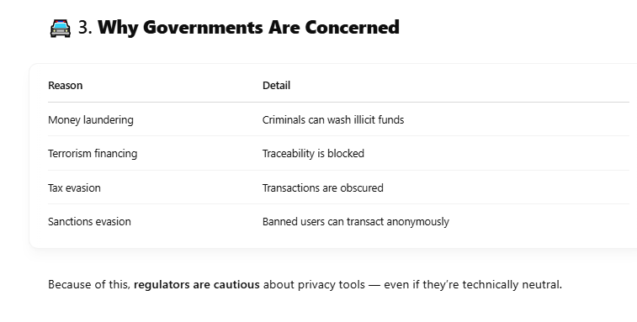

Slide 36
Principles for mixing services
2. Uniform transactions
In particular: all mix
transactions must have the
same value!
“Chunk size”
Mixcoin: Anonymity for Bitcoin with accountable mixes
J. Bonneau et al.
Financial Cryptography 2014

Slide 37
Principles for mixing services
3. Client side must be
automated
Desktop wallet software
Mixcoin: Anonymity for Bitcoin with accountable mixes
J. Bonneau et al.
Financial Cryptography 2014

Slide 38
Principles for mixing services
4. Fees must be all-or-nothing
Probabilistic fees:
0.1% mixing fee =
mix will swallow chunk
with 0.1% chance
Mixcoin: Anonymity for Bitcoin with accountable mixes
J. Bonneau et al.
Financial Cryptography 2014
Current mixes follow none of these principles

Slide 39
Remaining problem: trusting mixes
Stay in business, build up reputation
Users can test for themselves
Cryptographic “warranties”
Notes:
Current status: frequent reports of theft

Slide 40
Currently no reputable dedicated mix
Caution: Mixing services may themselves be operating with anonymity. As such, if the mixing output fails to be delivered or access to funds is denied there is no recourse. Use at your own discretion.
— Bitcoin Wiki
Notes:
Bootstrapping problem

